Slide 1

Horsham YMCA FC 3G Artificial Grass Pitch (AGP) Project
Project Overview for Horsham District Council,
Councillor Roger Noel, Cabinet Member for Leisure and Culture and
Steve Hawker, Leisure Strategy & Client Manager, HDC
13th October 2022

Slide 2

Agenda
Welcome & introductions
AGP Project vision, participation, & reach
Project plans, timescale, financing, community benefits
Pre-planning report
Pitch / ground walk about
Further Q&A
Summary and wrap up

Slide 3
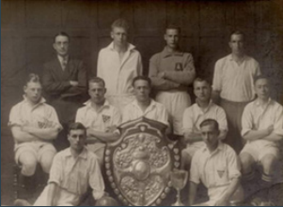
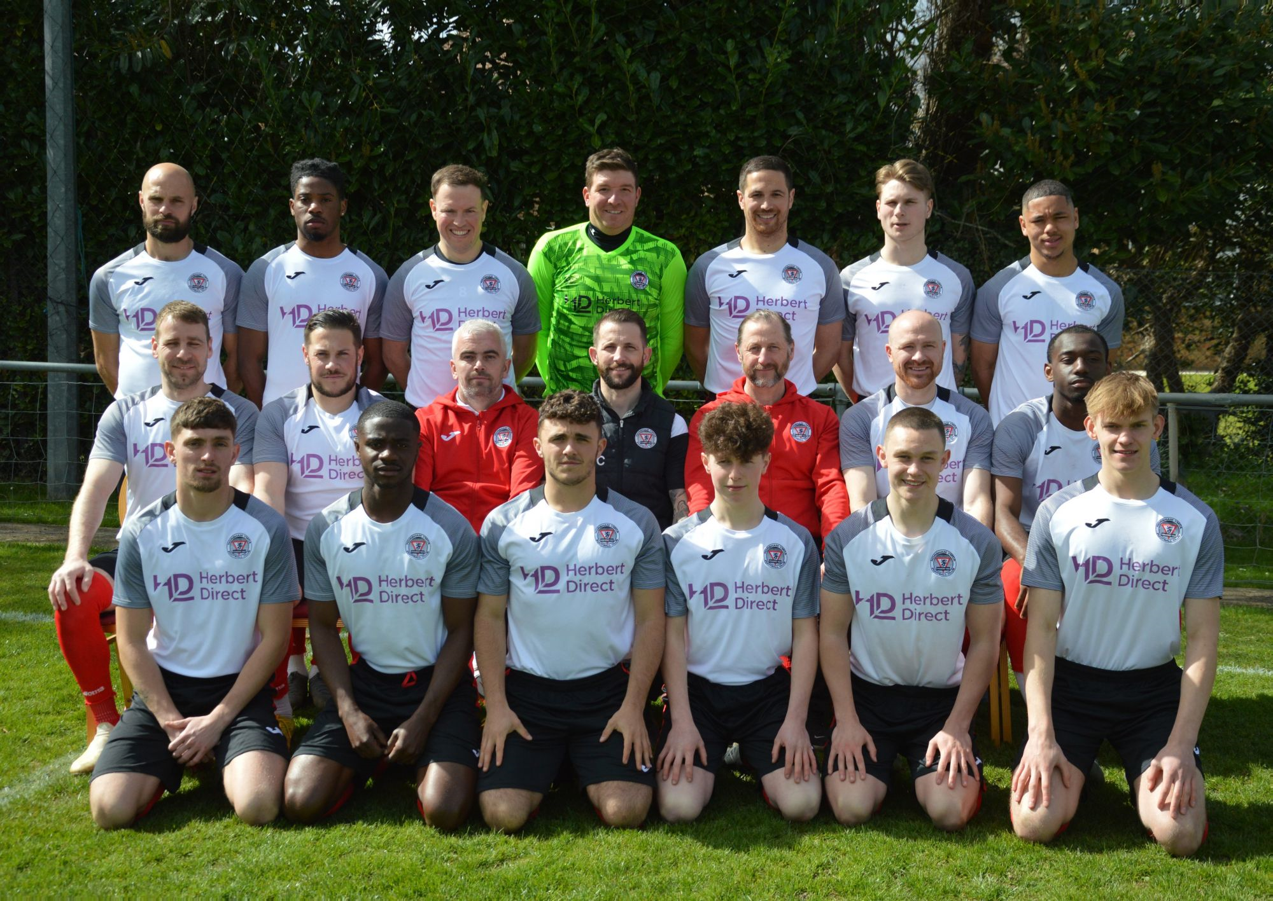
Welcome

Slide 4
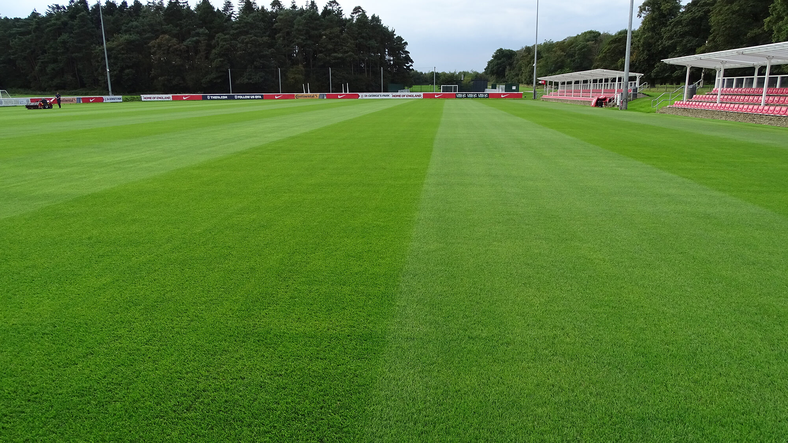
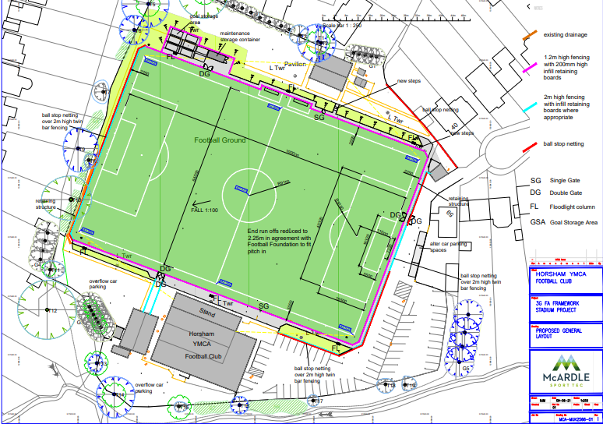
Vision for YMCA Horsham FC
A new 3G Artificial Grass Pitch at Gorings Mead, Horsham, West Sussex
Photo of Artificial Grass Pitch at the Football Association St George’s Park site
Plan of the Gorings Mead AGP

Slide 5
Project participation and reach
Opening Goring’s Mead to wider community use
Clubs and Organisations working with us
Includes;
A variety of age groups, youth teams, adults, veterans, male and female teams
Includes mental health groups and YMCA residents
The Unique partnership of YMCA Downslink and Horsham YMCA FC can engage hard to reach groups
Positive impact on,
Childhood obesity Physical and mental health Substance misuse
Club Teams | Horsham YMCA FC First Team Under 18s Under 21s New women’s team | Southwater Royals FC Fist and second team U10-U18 boys and girls | Sparrows FC Women’s Football, Youth Football, Mini Football | Tigers FC Youth Football, Mini Football | Hills Farm Roffey Vets Veterans | AFC Acorns Women’s football team | YMCA Downslink Supported housing residents. UASC | Brighton and Hove Albion FC Albion in the Community
Notes:
Current demand – with written expressions of support, with agreed plans for use detailed in the 20% usage budget and 10% for YMCA Horsham
– these include: Sparrows, Veterans, Crawley Town FC, Power Leagues, Horsham District Youth Football League (finals and 5 asides in summer) and YMCA Horsham FC (no charge)

Slide 6
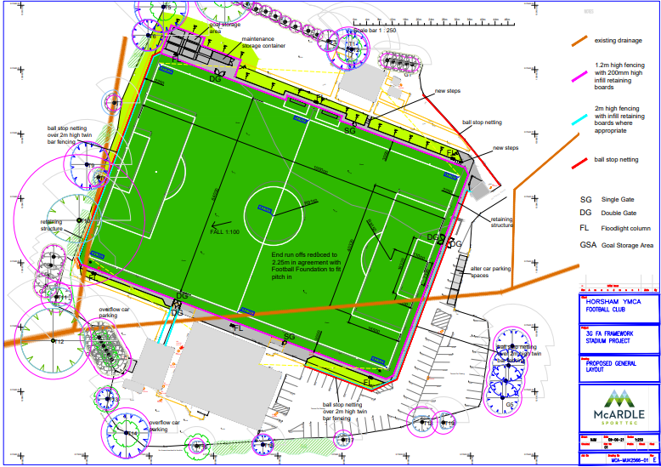
New Pitch Plans

Slide 7
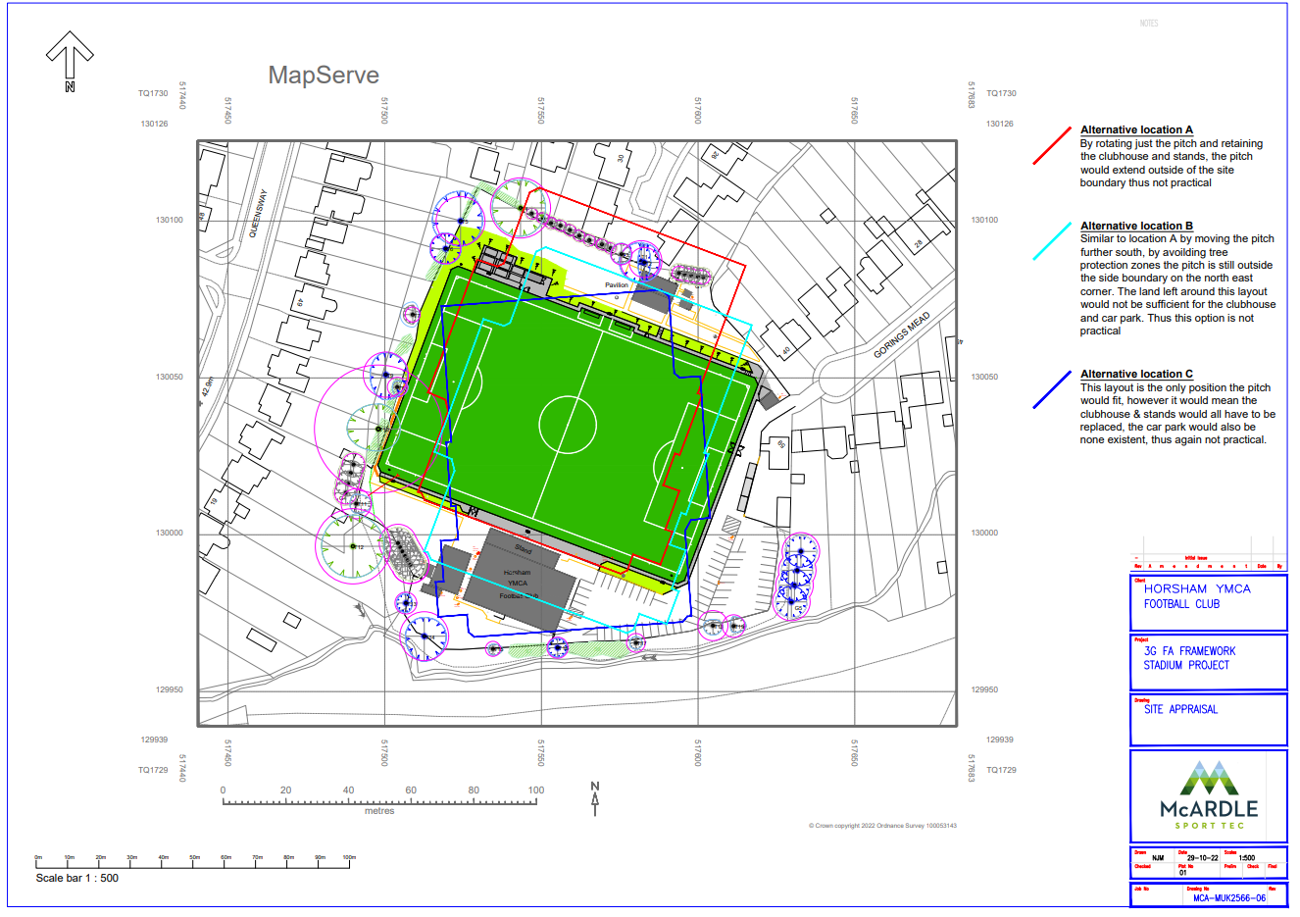
Site layout limits pitch orientation options

Slide 8
Football Foundation: Framework Delivery Process Seven Steps
FF AGP Build Seven Step Process – 3.5 completed
Feasibility Stage A
Feasibility Stage B
FMC Tender and Supplier Selection
Supplier Technical Design, Planning application, Grant award
Construction, and testing
Handover, and operation
Initial 12 months, defects phase
Notes:
High level Plan

Slide 9



Project Timescale
Timescale
We are planning to submit a planning application in the autumn of 2022 and subject to planning permission and receiving a grant from the Football Foundation and funding from YMCA Downslink Group, as well as Club fund raising activity for matching funds we aim to raise the necessary finances.
We then aim to construct the new pitch in the off season (summer of 2023), with the new pitch commissioned and available to hire and play on from September 2023.

Slide 10
AGP Funding – Current status Oct‘22
Gorings Mead, Horsham, Artificial Grass Pitch (AGP)
Financial Framework
 |  |  |  |  |  |  |  | Comments
Costs |  |  |  |  |  | £
3G Stadia AGP Cost (Tiger Turf / McArdle Sport) |  |  |  |  |  | 858,051 |  | FF Stage 3 cost based on initial surveys & tender. Technical design & planning submission being prepared to deliver final guaranteed maximum price (GMP2)
Community Interest Company (CIC) start up costs |  |  |  |  |  | 22,300 |  | Business Plan for FC CIC
Contingency |  |  |  |  |  | 19,649 |  | Contingency for unplanned costs
Total Cost |  |  |  |  |  | 900,000
Funding |  |  |  |  |  | £
Football Foundation |  |  |  |  |  | 600,000 |  | Football Foundation 3G AGP Grant, subject to grant approval
Football Foundation |  |  |  |  |  | 88,000 |  | Football Foundation Stadium Improvement Fund, subject to grant approval
FC Funds |  |  |  |  |  | 50,000 |  | From YMCA Horsham FC Club funds, subject to Board approval
YMCA Downslink |  |  |  |  |  | 100,000 |  | YMCA Downslink Group funds, subject to YMCADLG Board approval
Sub-total |  |  |  |  |  | 838,000
Remaining gap |  |  |  |  |  | 62,000

Slide 11
Community Benefits of an AGP
Sustaining an historic site for football and other sports making it fit for the future, and retaining the green space
A facility that can be used year-round by people of all ages
Physical and mental health benefits for all participants
Function spaces, hall and bar to rent for events like Weddings and Parties
Landscaping and biodiversity making the site more attractive to visit and walk around
New LED flood lights which are more focused and environmentally friendly
Secure bicycle storage for users and visitors

Slide 12
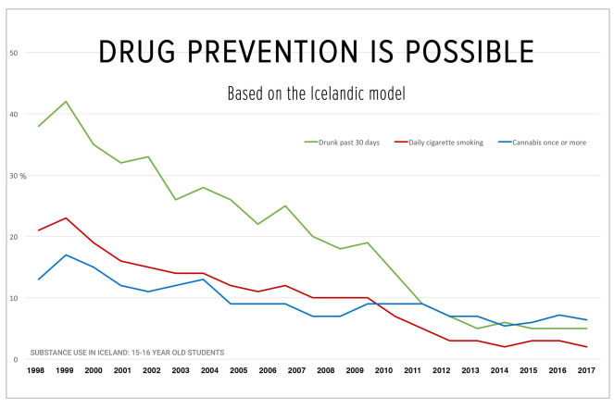
Teenage Substance Misuse Lessons from Iceland
Iceland has had over 20 years of success in reducing alcohol abuse and substance misuse by young people. They have gone from the bottom of the European League table to the top for alcohol and other addictions by providing out of school facilities for young people including youth clubs and especially sports facilities. This has had a positive impact on reducing levels of anti social behaviour and crime.

Slide 13
Pre-planning report
Appearance and Landscaping
Including TPOs
Amenity Impacts – Neighbourhood considerations
Highways Impacts – Neighbourhood considerations
Flood Risk and Drainage
Ecology
Water Neutrality
CIL

Slide 14
Agenda
Welcome & introductions
AGP Project vision, participation, & reach
Project plans, timescale, financing, community benefits
Pre-planning report
Pitch / ground walk about
Further Q&A
Summary and wrap up

Slide 15


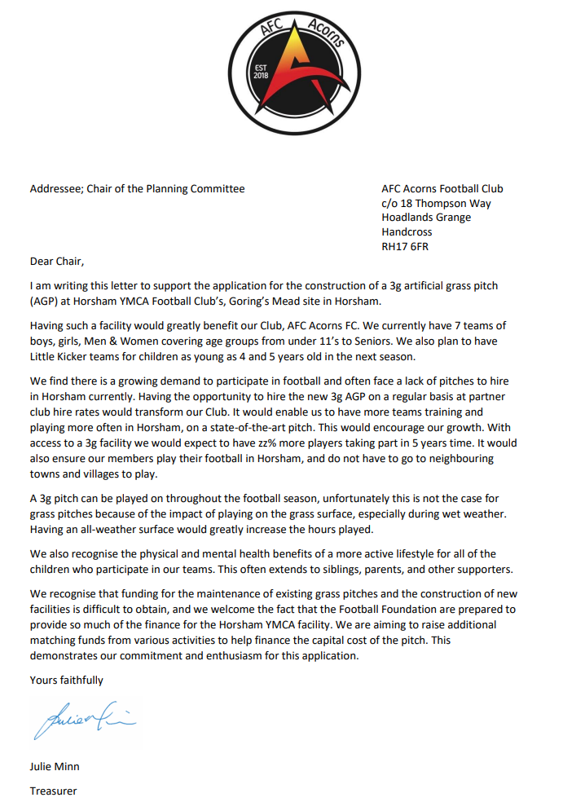


Summary and wrap up
Letters of support received from several partner clubs
We expect more will follow….

Slide 16
Backup

Slide 17
3G AGP - Questions and Answers
Why do we need a 3G Artificial Grass Pitch (AGP)?
Strong and growing demand for football pitches in the Horsham area, particularly from girl’s/ women’s teams
HDC Playing Pitch Strategy published in 2019 recognises the benefit of new 3G pitches to residents physical and mental health and highlights the need for seven (7) AGPs in the Horsham District. Currently there are only two (2).
Why a 3G AGP at Gorings mead?
Football has been played on at Goring’s Mead since 1928.
A 3G pitch would be a asset, which could be used by the wider community.
The pitch hire revenues would help fund the Horsham YMCA Football Club and also provide the youth charity YMCA Downslink with additional funds to support its work with young people.

Slide 18
3G AGP - Questions and Answers
What is the environmental impact of a 3G AGP?
The Club and Downslink Group are very respectful of our neighbours and the natural environment
As part of the planning process full environmental studies (trees, ecology including wild-life and plant impact, water usage) are being undertaken.
Issues such as traffic and parking will be considered as part of the planning process.
New LED flood lights will confine the light to the pitch area and reduce electricity consumption.
Noise levels will be considered if necessary mitigation measures will be needed.

Slide 19
Original Project Plan – as at June ’21 before starting pre-planning and planning process
 | Horsham YMCA AGP Project
 | Year | 2020 |  |  |  | 2021 |  |  |  |  |  |  |  |  |  |  |  | 2022
Stage | Activities | Duration | Oct | Nov | Dec | Jan | Feb | Mar | Apr | May | Jun | Jul | Aug | Sep | Oct | Nov | Dec | Jan | Feb | Mar | Apr | May | Jun | Jul | Aug | Sep | Oct | Nov | Dec
 |  | Weeks
1 | Feasibility Stage Phase A | 6 |  |  |  |  |  | D
2 | Feasibility Stage Phase B | 2
3 | FMC Tender Stage | 7 |  |  |  |  |  |  |  |  |  | D
4.1 | Supplier Technical Design and Planning Permission | 16 |  |  |  |  |  |  |  |  |  |  |  |  |  | D
4.2 | Planning Process | 6 |  |  |  |  |  |  |  |  |  |  |  |  |  |  | D
4.2 | Final Project Cost (Guaranteed Maximum Price) | 4
4.4 | Foootball Foundation Panel Process and Grant award | 6 |  |  |  |  |  |  |  |  |  |  |  |  |  |  |  |  |  | D
5 | Construction Phase | 12
5.1 | Test and commissioning | 2
6 | Operation ( 12 month Defects Phase ) | 52
 | YMCA FC and Community Engagement
M
M
M
M
D = Decision M = Milestone

Slide 20
Contacts
Neil McHugh Planning Consultant,
MUGA UK Ltd,
email info@muga-uk.co.uk
tel 01509 503408
mobile 07525 715205
Tom Fearn Estimator,
McArdle Sport Tec,
email TomF@mcardlesport.co.uk
tel 01492 827810 Ext 1
mob 07388 994697

Slide 21
Contacts
Tim Bass Business Development Manager,
YMCA Downlink Group,
email tim.bass@ymcadlg.org
mobile 07572 857925
Mike Whiteford Chair,
YMCA Horsham YMCA Football Club,
email Mike.Whiteford@horshamymcafc.co.uk

